Slide 1
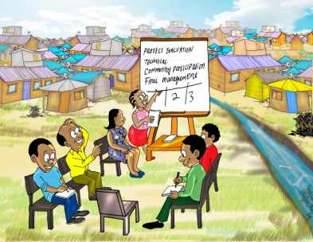
Introduction to the
Kenyan Water Sector and Sanitation Sub-Sector

Slide 2
Background
Before 1974, water was managed by the Department of Water Development (DWD) which was housed in various ministries including Public Works, Natural Resources and Agriculture.
In 1974 the Government upgraded the DWD in Ministry of Agriculture’s into a full Ministry of Water.
In 1999 the Ministry developed a National Water Policy (Sessional Paper No. 1 of 1999), which was adopted by Parliament in April, 1999 to provide the policy direction on Water Resources Management and Development.
The Policy induced the water sector reforms, moved Ministry from direct service provision to policy formulation, resource mobilization and coordination functions. Regulation of water services and Water Resource management were also made as separate functions.
To implement the Policy and water sector reforms, Water Act, Cap 372 was repealed and the Water Act 2002 was enacted.

Slide 3
The water sector reforms
The Water Act 2002 was gazetted in 2003 and implementation began in 2004
During 2004 to 2005, new institutions were established and given legal mandates according to the Act
These institutions include the:
Water Services Regulatory Board (WASREB) - regulation of water services
Eight (8) Water Services Boards (WSBs) - asset holding and development
Water Services Trust Fund (WSTF) - pro-poor basket fund of water sector
Water Resources Management Authority (WRMA) - WRM and development
Water Service Providers (WSPs) - provision of Water Services
The transfer plan was approved in July, 2005 and the Ministry of Water and Irrigation initiated the transfer of mandates, assets and personnel to the new institutions

Slide 4
The water sector reforms
The reviewed institutional set up includes (Water Act 2016):
Ministry of Water and Irrigation Services (State Department of Water) - policy formulation, coordination (Ministry re-created in 2015)
Water Services Regulatory Board (WASREB) - regulation of water services
Water Works Development Agency - asset development (national)
Water Sector Trust Fund (WSTF) - pro-poor basket fund of water sector
Water Resources Authority (WRA) - regulation of water resources
Water Resources Basin Committees - management and development water resources with Water Resources Users Associations (WRUAs)
Water Service Providers (WSPs) - provision of Water Services with county government (county or cross county)
Water Harvesting and Storage Authority - water storage and flood control
Kenya Water Institute (KEWI) - training and research

Slide 5
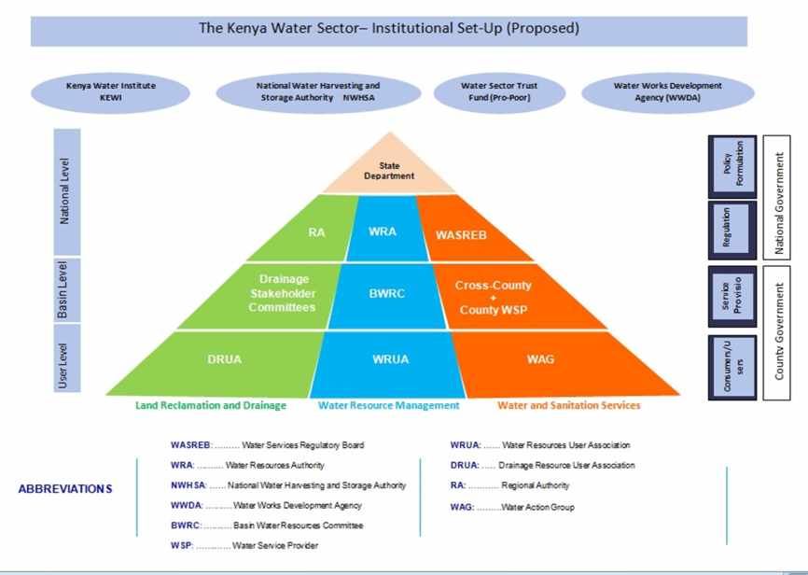

Slide 6
The Ministry of Water and Irrigation Services
The core functions of the Ministry are:
Water Resources Management Policy
Water Catchment Area Conservation, Control and Protection
Water and Sewerage Services Policy
Water Quality and Pollution Control Policy
Waste Water Treatment and Disposal Policy
Flood Control and Land Reclamation/Regional Development Policy
Dam Construction and Management
Onsite Sanitation Management
Management of Public Water Schemes & Community Water Projects

Slide 7
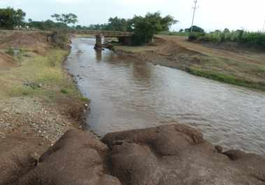
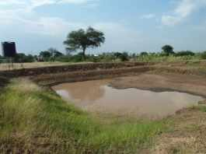
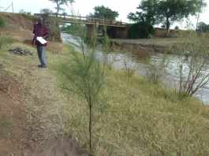
The Water Resources Management Authority (WRMA)
WRMA is charged with responsibility for:
Managing, (this will go to Basin Water Resource Committees + WRUAs)
Regulation
Protecting (this will go to Basin Water Resource Committees +WRUAs)
Apportioning and
Conserving water resources, including trans-boundary+ sea waters

Slide 8
The Water Resources Management Authority (WRMA) (continued)
For WRMA to achieved its mandate, the country is divided into the following six regions:
• Lake Victoria North Catchment
• Lake Victoria South Catchment
• Rift Valley Catchment
• Athi Catchment
• Tana Catchment
• Ewaso Nyiro North Catchment
Catchment Area Advisory Committees (CAACs) work is to help the WRMA in water and environmental conservation activities through the regional managers

Slide 9
The Water Services Regulatory Board (WASREB)
The regulatory role of the WASREB includes:
Issuing licenses
Setting service standards
Providing guidelines for setting tariffs
Providing mechanisms for handling complaints
The responsibility for providing water and sewerage services is vested to the 47 Counties
The Water Service Boards (WSBs) are still responsible for asset development during the transition period to full devolution of water services. In the previous Water Act 2002,their roles were regulators, managers, operators, developers of assets and appointers of WSPs.

Slide 10
The Water Service Providers (WSPs)-County + Cross County
WSP is defined as “a company, non-governmental organization or other organization providing water services under and in accordance with an agreement with a licensee (the Water Services Regulatory Board)
The key responsibilities of the WSP are:
Provision of water services within the area
specified in the license
Operation, maintenance and development
of County assets for water service provision
Complying with quality standards and service
levels
Billing and revenue collection

Slide 11
The Water Sector Trust Fund
The objectives of the proposed Water Sector Trust Fund (which is supposed to replace the Water Services Trust Fund) is to assist in the financing water resources management and development of water services for poor including:
Community level initiative for the sustainable management of water resources
Development of water services in rural areas considered commercially unviable for provision of water services by licensees
Development of water services in the under-served poor urban areas
Research activities in the areas of water resources management and water supply, sewerage and onsite sanitation

Slide 12
Cooperating Partners of the WSTF
The cooperating partners of the WSTF include the following:
Government of Kenya
GIZ (German International Cooperation)
KfW (German Development Bank)
Bill and Melinda Gates Foundation
European Union
Sida (Government of Sweden)
Danida (Government of Denmark)
UNICEF (United Nations Children's Fund)
WSP (Water Sector Programme of the World Bank)
AfDB (African Development Bank)
K-Rep Bank

Slide 13
The Constitution of Kenya 2010
The Constitution of Kenya (CoK) 2010 establishes two forms of government:
Central Government (responsible for water resources conservation and management)
County Government (responsible for water supply, sewerage and onsite sanitation service provision)
The constitutions delineates services that will be provided at the two levels of government and provision of water and sanitation services is the role of the County Governments

Slide 14
The Water Act 2016
It is an Act of Parliament to provide for water management and development of water and sewerage services and repeal of the Water Act 2002
The Water Act 2016 has now been enacted and awaits operationalization.
The Water Act 2016 provides for the right of every Kenyan to safe water and sanitation (CoK 2010, Bill of Rights)!!

Slide 15
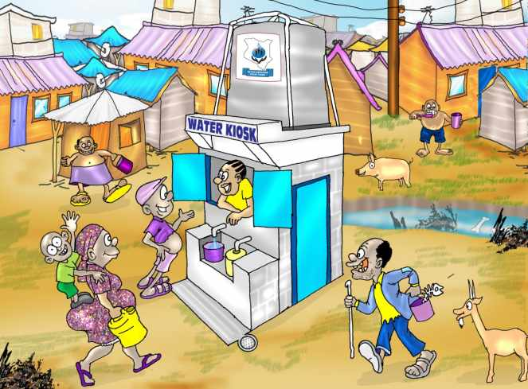
Thank You for Your Attention

